Slide 1
Weekly Meeting
Jan 5, 2022
Gwangwoo Kim

Slide 2
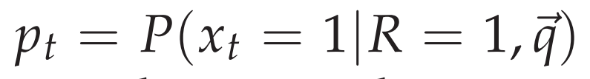
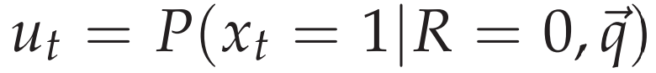
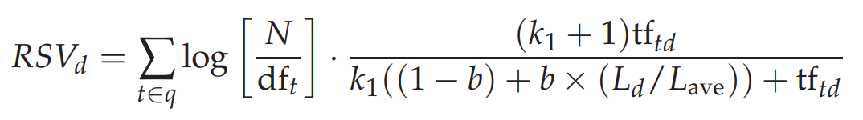
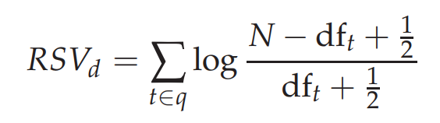
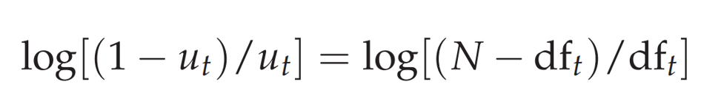
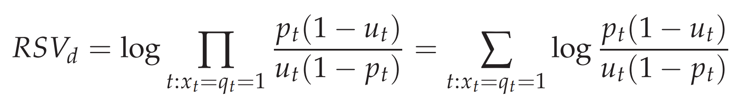
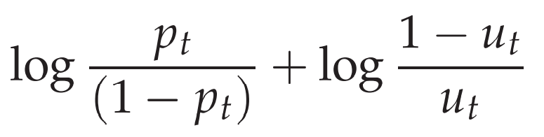
smoothing

Slide 3
For fixed q(=one word) and d
u =
t =
$$p_{t}=\exp\left(u(t−1\right)/(1+exp⁡(u(t−1))$$
Q = 15000 D = 28000
→ We have a matrix of size 15000x28000

Slide 4
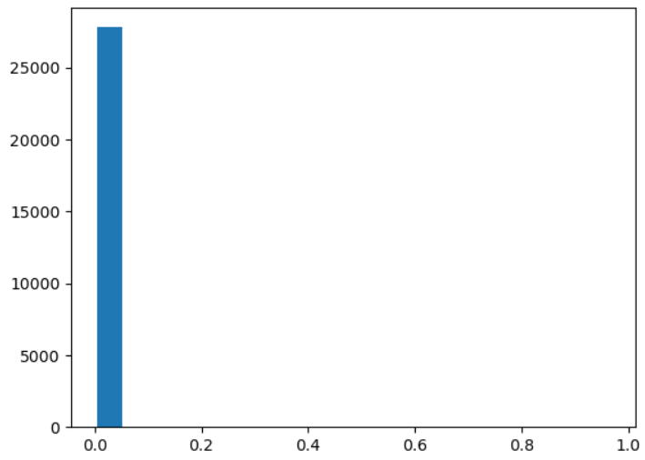
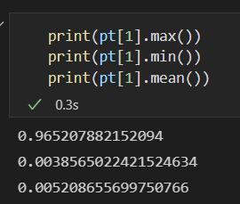
Q=‘paragraph’

Slide 5
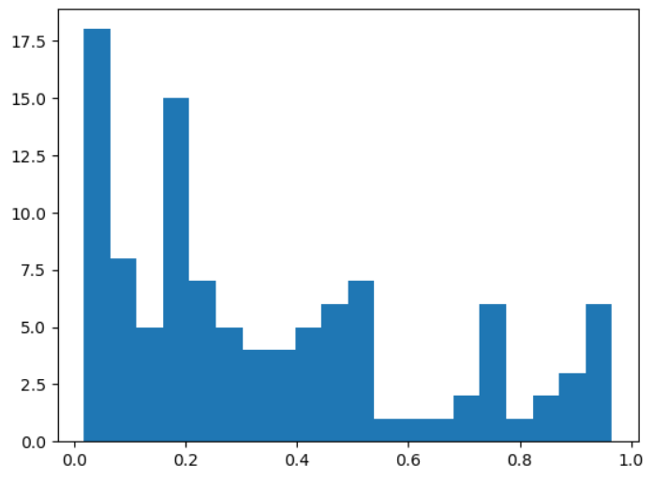
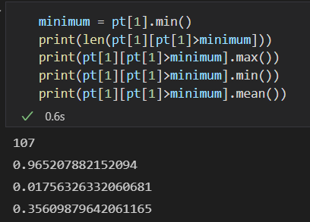
Q=‘paragraph’
num=102

Slide 6
Q=‘paragraph’
comment
bm_score
transformed
This is the probability that for q=‘paragraph’ and d=the above, there exists a word q in d.

Slide 7
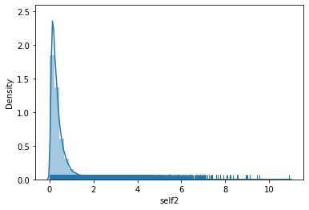
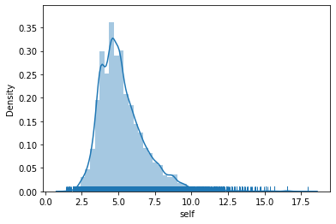
search
>2.5
Q=all data
Database
q: word=[transformed probability]

Slide 8
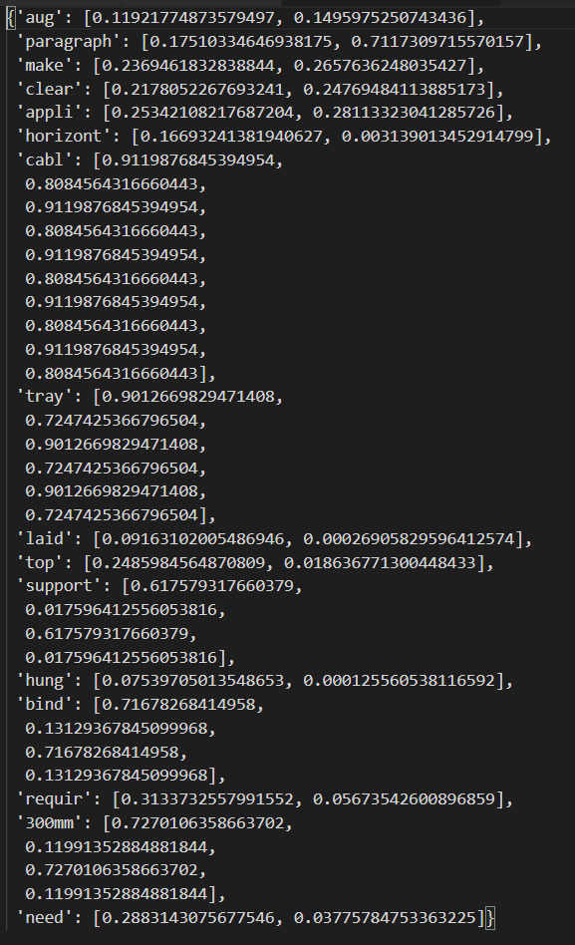
Example:
>2.5

Slide 9
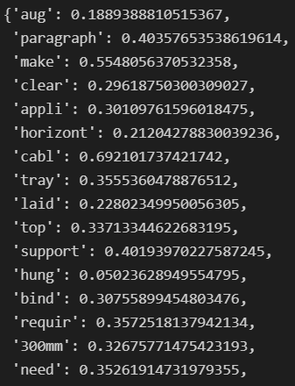
Mean of all values for each word.
So word probability does not depend on documents anymore.

Slide 10
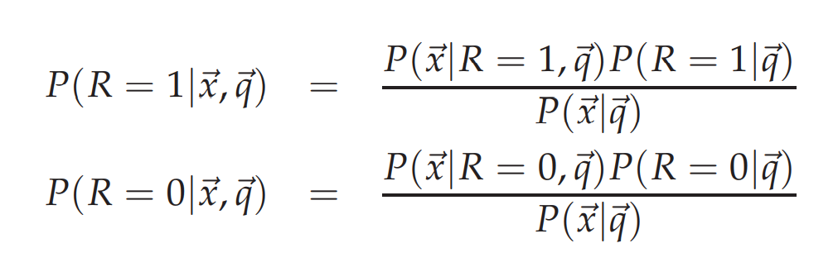


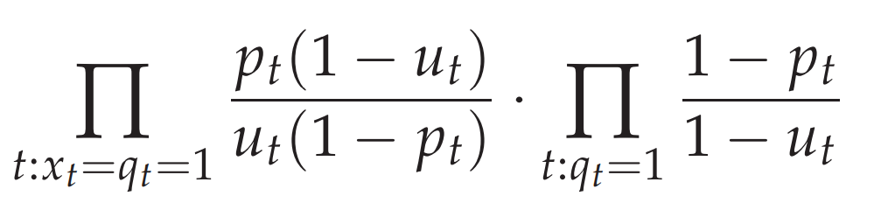


Slide 11







12 Language models for information retrieval
Data set
Descending order
$$d_{1}$$
$$P(R=1|d_{1},q)$$
$$q$$
$$d_{2}$$
$$P(R=1|d_{2},q)$$
$$d_{3}$$
$$P(R=1|d_{3},q)$$

Slide 12







12 Language models for information retrieval
Descending order
Data set
$$P(q|M_{d_{1}})$$
$$d_{1}$$
$$q$$
$$P(q|M_{d_{2}})$$
$$d_{2}$$
$$P(q|M_{d_{3}})$$
$$d_{3}$$

Slide 13
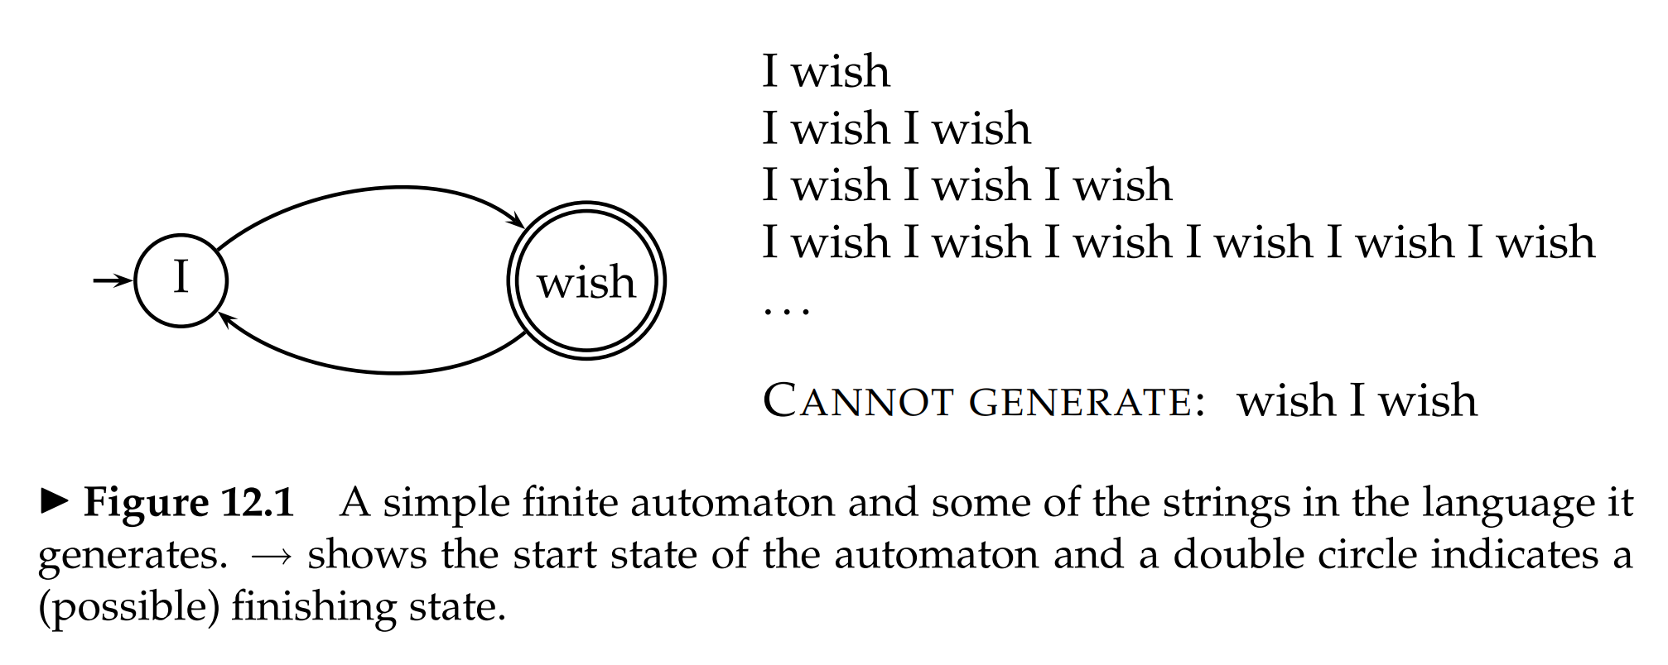
12.1.1 Finite automata and language models

Slide 14
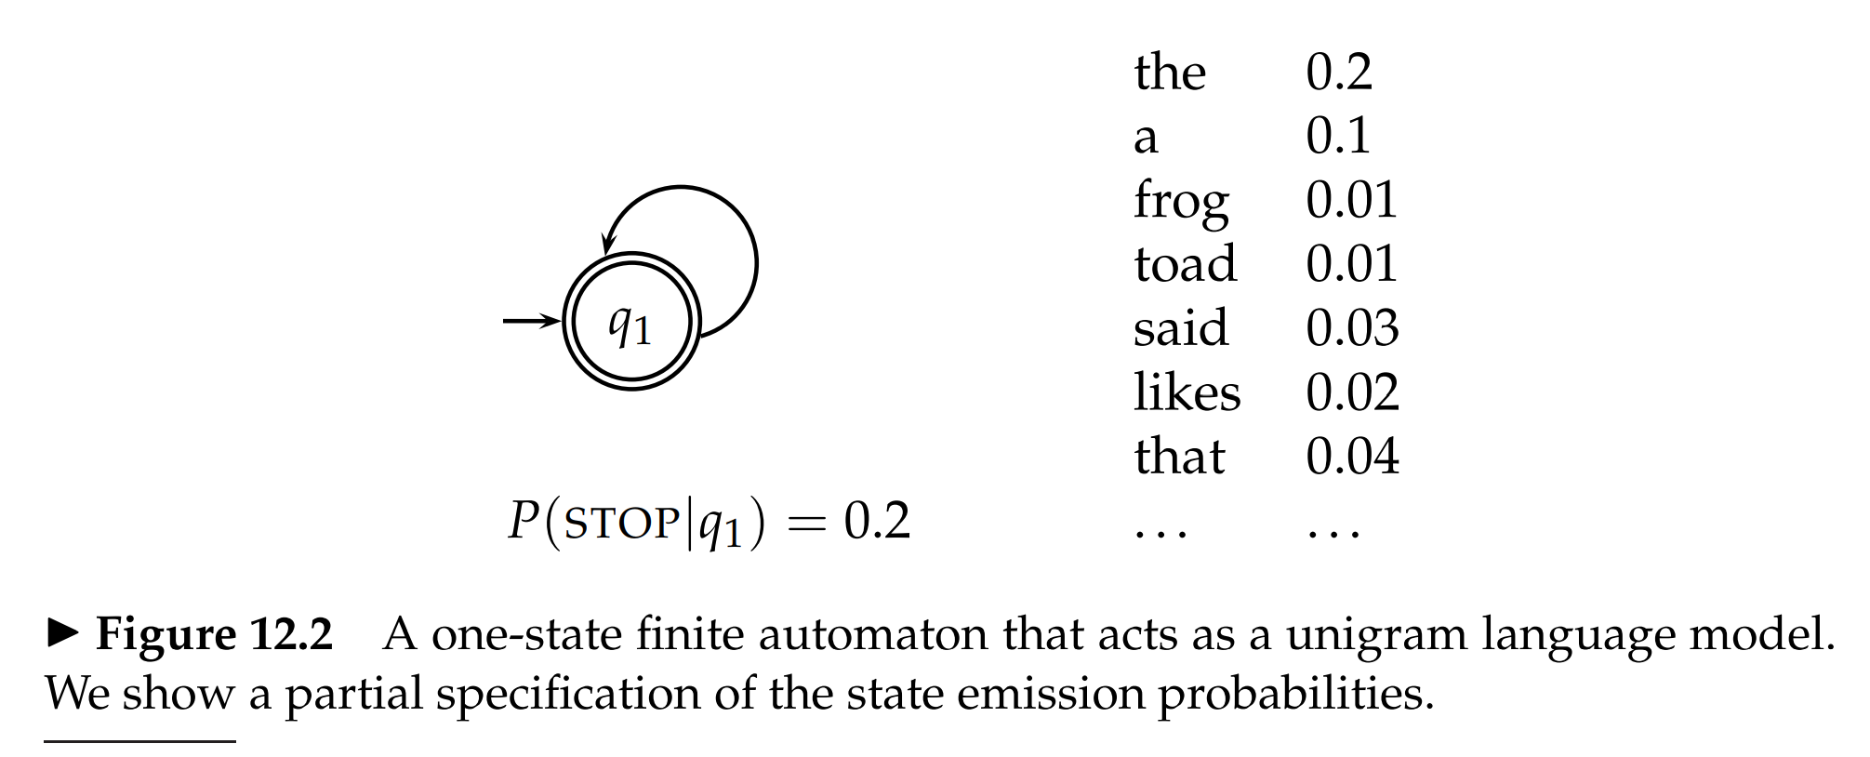
12.1.1 Finite automata and language models

Slide 15
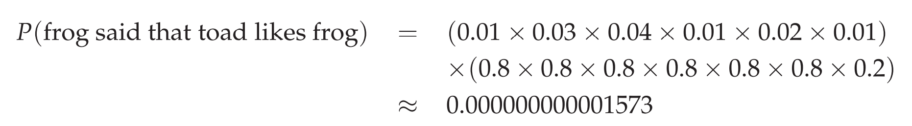
12.1.1 Finite automata and language models

Slide 16
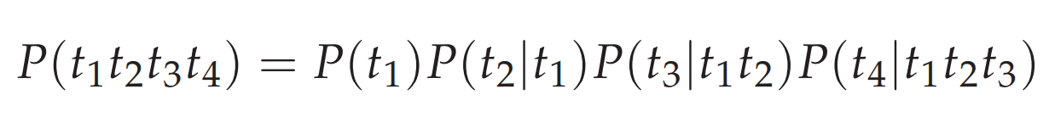
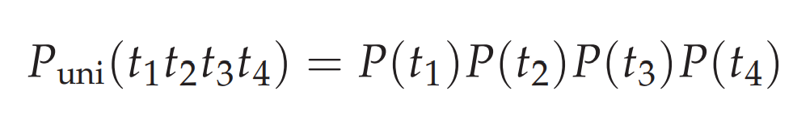
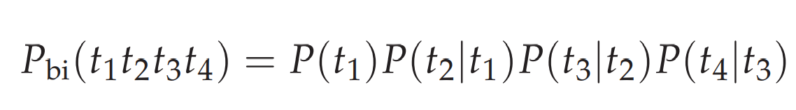
12.1.2 Types of language models

Slide 17
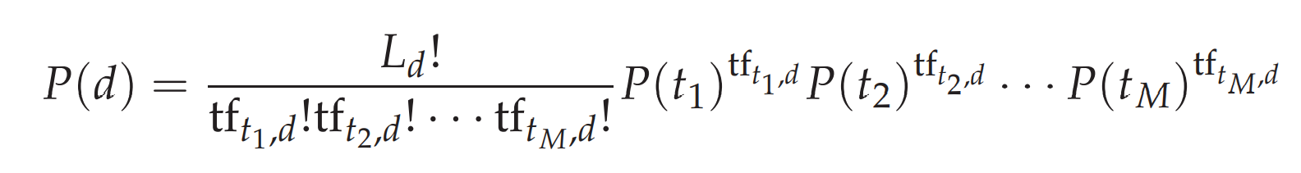
12.1.3 Multinomial distributions over words

Slide 18
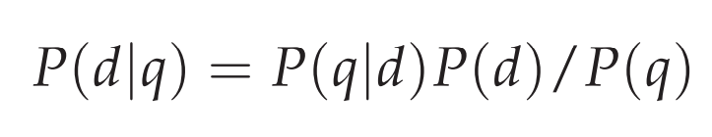
12.2.1 Using query likelihood language models in IR
treated as uniform across all docs
constant
Target probability

Slide 19
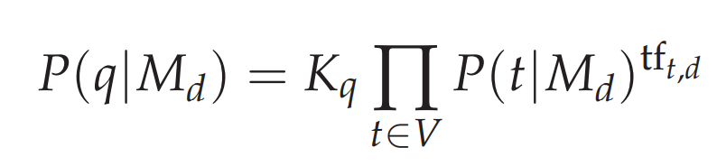

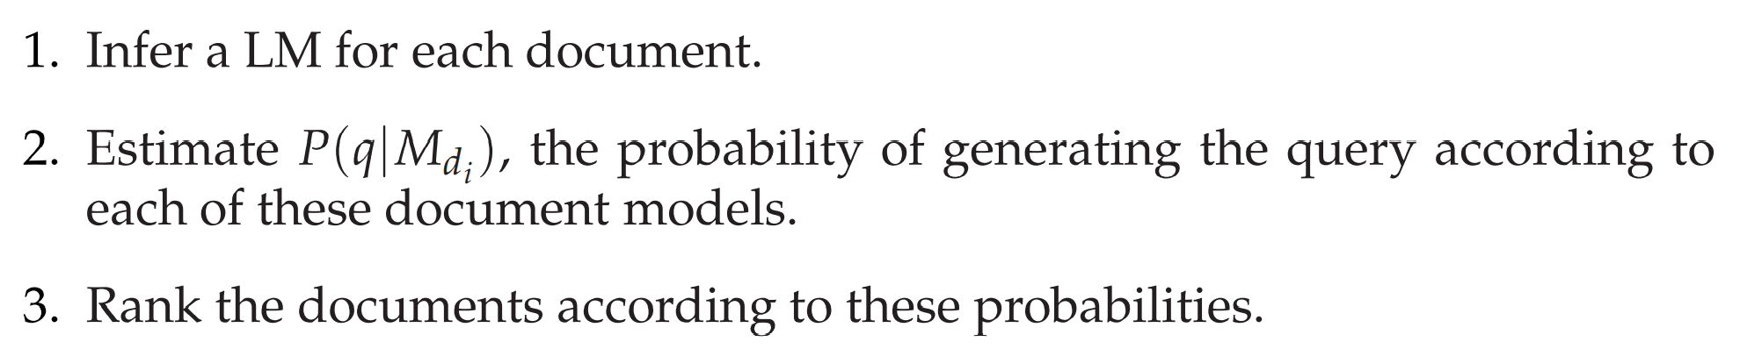
12.2.1 Using query likelihood language models in IR
where

Slide 20
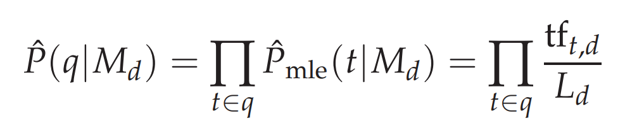
12.2.2 Estimating the query generation probability
Note: Some words will not have appeared in the document at all, but are possible words for the information need, which the user may have used in the query. That is, $\hat{P}\left(t | M_{d}\right)=0$ for a term missing from a document $d$. If so, such probabilities will be degenerated.

Slide 21
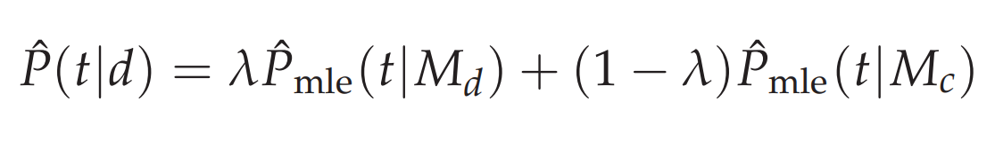
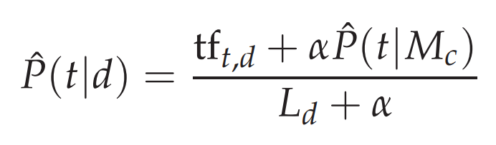
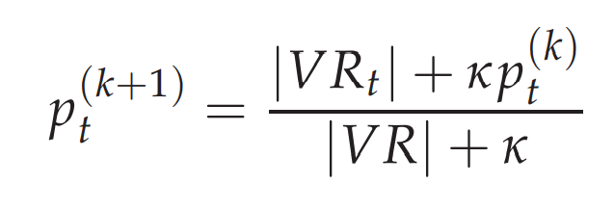
12.2.2 Estimating the query generation probability
Suggestion 1 (Jelinek-Mercer smoothing) For $0<λ<1,$
Suggestion 2 (Bayesian updating process)
Cf.

Slide 22
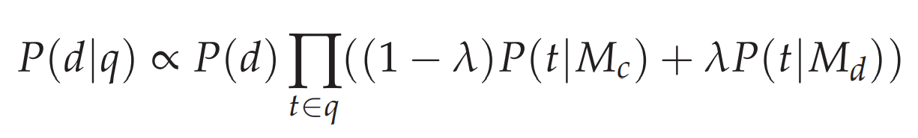
12.2.2 Estimating the query generation probability

Slide 23
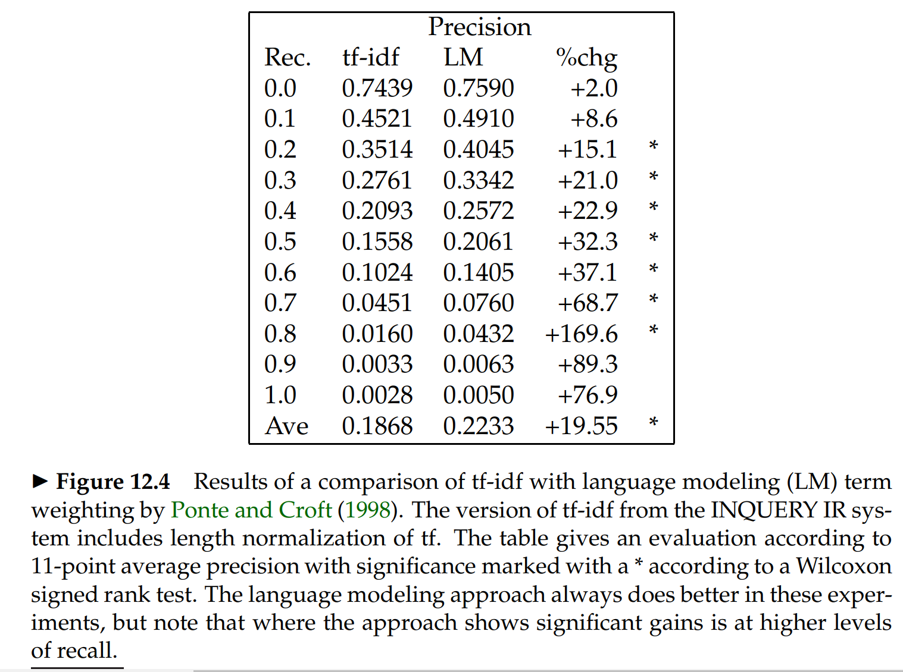
12.2.3 Ponte and Croft’s Experiments

Slide 24
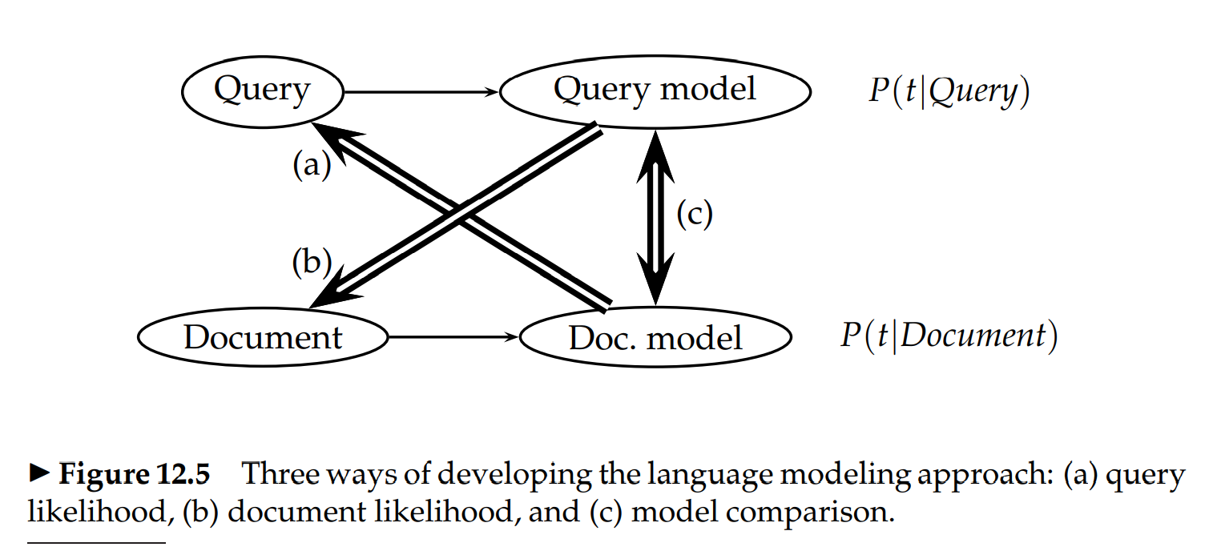
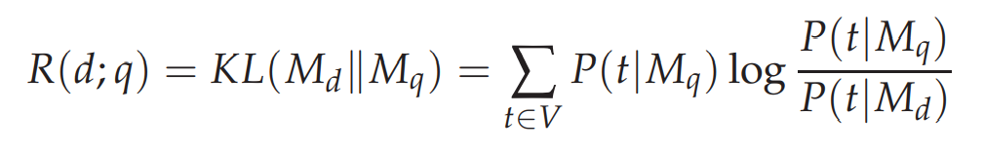
12.4 Extended language modeling approaches

Slide 25
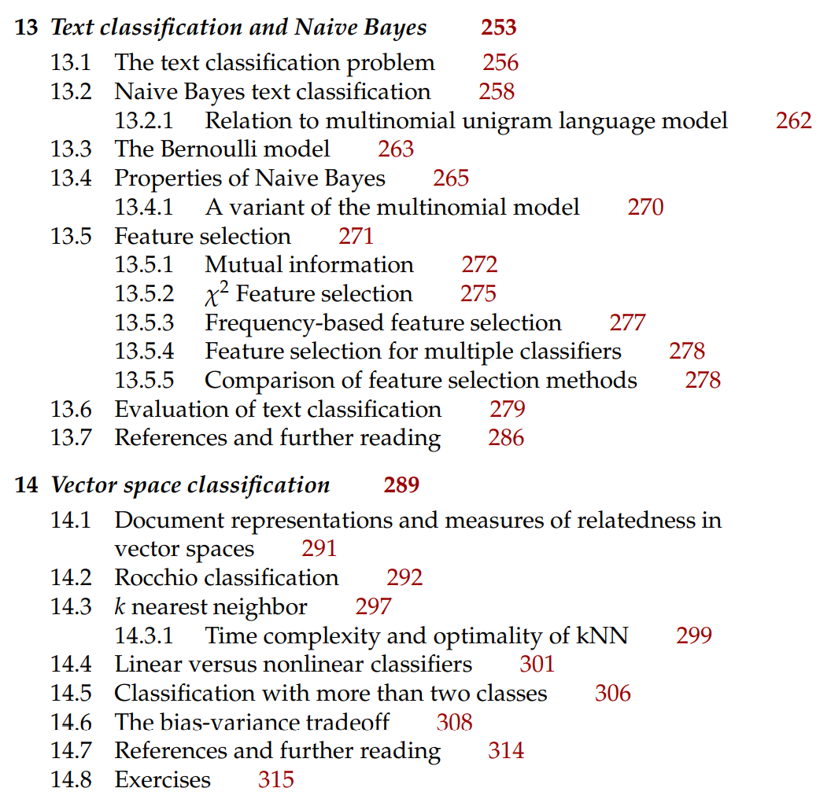
Next Contents

